Slide 1

Data Analysis Essentials
Cornerstone Project
OTT STREAMING ANALYTICS
Presented by
Ch . Kusumitha Keerthi (25B11CS159)
Praveen Goswami (25B11CS782)
A . Aparajitha (25B11CS034)
K . Harsha Vardhan (25B11CS430)
Guide : Mr. K. Ashok Teja, Assistant Professor, CSE Dept.
Department of Computer Science and Engineering

Slide 2

Contents
Requirements
Problem Understanding
Methodology
Introduction
Data Visualization
Current Approach & Limitations
Key Insights & Analysis
Proposed Approach
Implementation Workflow
Dataset Description
Conclusion

Slide 3
Problem Understanding
OTT platforms provide a large amount of movies and TV shows, so the data becomes difficult to manage and understand.
The main problem is to study this data and find useful information such as popular genres, platform-wise content, release-year trends and the difference between movies and TV shows.
Our project uses data analysis to clean the OTT datasets, study the patterns and present the results using simple charts.

Slide 4
Introduction
OTT platforms such as Netflix, Amazon Prime Video and Disney+ contain a large amount of content.
The datasets include movies, TV shows, genres, countries, ratings, language and release years.
Looking at raw data makes it difficult to understand the main patterns. We use Python to clean the data and make the analysis easier.
Pandas and NumPy are used for data handling. Matplotlib are used to create charts and graphs.
The final results help us compare platforms and understand OTT content trends.

Slide 5
Current / Manual Approach
OTT data is usually available in CSV and Excel files.
Finding popular genres and yearly trends manually is not easy.
Checking thousands of records manually takes a lot of time.
Missing values and duplicate records may be missed.
Comparing platforms row by row is difficult.
Raw tables are difficult to understand without charts.

Slide 6

Limitations of Manual Analysis
Manual checking takes more time when the dataset is large.
Comparing different OTT platforms becomes difficult.
Missing values and duplicate records can affect the results.
Trends and relationships between fields are not easy to identify manually.
Manual calculations can also lead to mistakes.

Slide 7
Proposed Approach
Load the Netflix, Amazon Prime Video and Disney+ datasets.
Check the number of rows, columns and data types.
Handle missing values and remove duplicate records.
Standardize the required columns for analysis.
Compare movies and TV shows across platforms.
Analyze genres, release years, countries and ratings.
Create charts to show the important patterns.
Summarize the main findings from the analysis.

Slide 8
Dataset Description
CLEANED OTT DATASETS USED FOR ANALYZING MOVIES AND TV SHOWS
Dataset Snapshot
Field | Description
title | Name of the movie or TV show
type | Movie or TV Show
genre / genres | Genre or category of the content
release_year | Year in which the content was released
country | Country related to the content
rating | Content rating / audience rating
duration | Movie duration or number of seasons / episodes
34,438
Total Records
Netflix: 31,991
Disney+: 1,447
Amazon Prime: 1,000
Data Quality & Tools
Missing values handled & duplicates removed
Columns standardized
TOOLS & LIBRARIES
Python • Pandas • NumPy • Matplotlib • Seaborn • Power BI

Slide 9

Requirements
Hardware Requirements
Software Requirements
Processor: Intel Core i3 or above
Windows / Linux / macOS
RAM: Minimum 4 GB
Python 3.x
Storage: Minimum 10 GB free space
Google Colab / Jupyter Notebook
Stable internet connection
Pandas and NumPy
Matplotlib
Power BI & Excel / CSV files

Slide 10
Methodology
PART 1: DATA PREPARATION
1
Module 1 – Data Loading
2
Module 2 – Data Acquisition & Filtering
• Load Netflix, Amazon Prime Video and Disney+ datasets.
• Check rows, columns and data types.
• Understand the basic structure of each dataset.
• Check the available files and required columns.
3
Module 3 – Data Extracting
4
Module 4 – Data Validation & Cleaning
• Handle missing values.
Checking formats, data types, and inconsistent values. Remove duplicates and handle missing, clean dataset for analysis.
• Remove duplicate records and unwanted entries.

Slide 11
Methodology
PART 2: ANALYSIS & VISUALIZATION
5
6
Module 5 – Aggregation & Representation
Module 6 – Data Analysis
Study movies, TV shows, genres, ratings and countries. Summaries for easy comparison and interpretation by using bar graphs etc.
Identify trends and patterns in the OTT data. Compare key factors like genres, ratings, and content types.
7
Module 7 – Data Visualization
8
Module 8 – Results & Interpretation
Create charts and graphs to present the analysis clearly. Use dashboards and visuals to highlight key trends and insights.
Summarize the key findings from the analysis. Interpret the results to identify useful trends and insights.

Slide 12
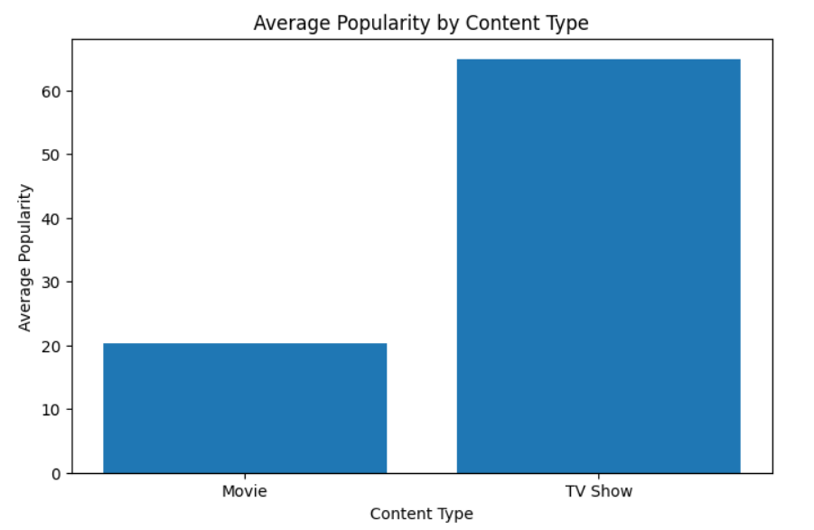
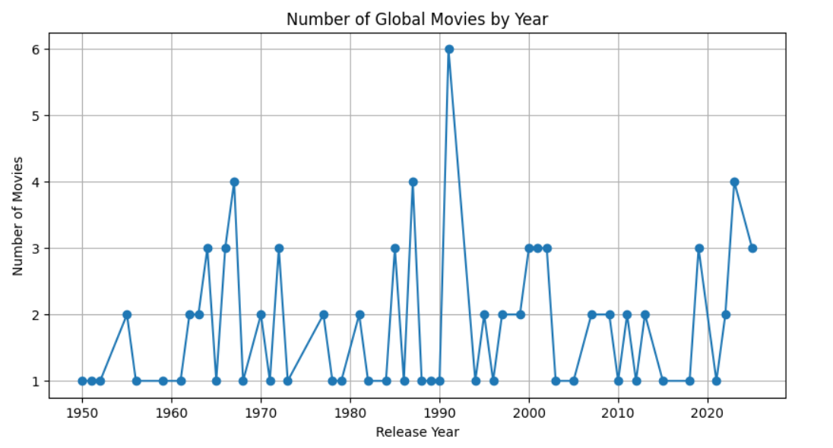
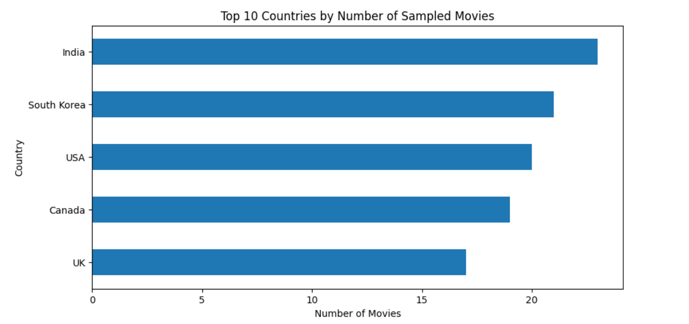
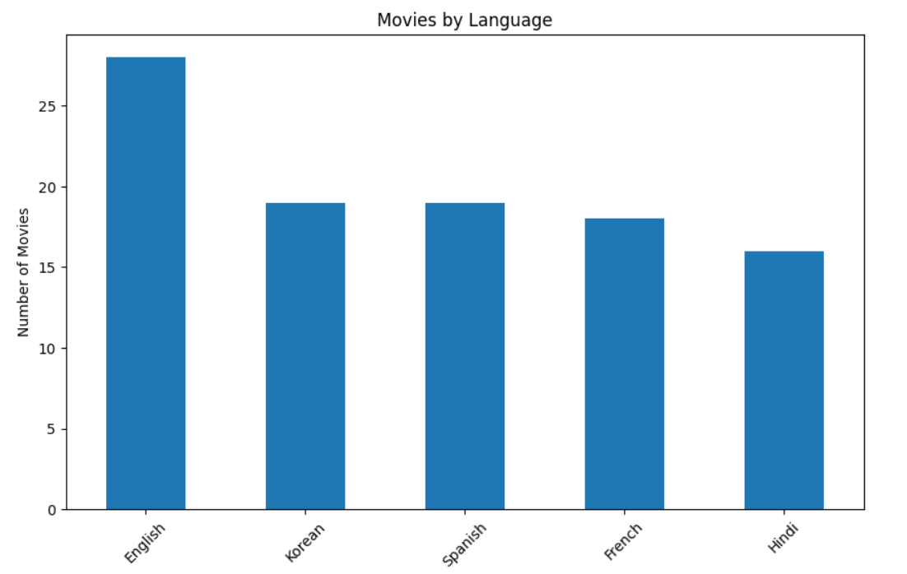
Data Visualizations
Data Visualization

Slide 13
Key Insights & Analysis
The three cleaned datasets contain a total of 34,438 OTT records.
Netflix has 31,991 records, followed by Disney+ with 1,447 and Amazon Prime with 1,000.
Netflix contains 16,000 movies and 15,991 TV shows, showing a nearly equal split.
In the Netflix dataset, Drama is the most common primary genre with 8,666 titles, followed by Comedy with 4,677.
Amazon Prime has 520 TV shows and 480 movies. Disney+ has 1,052 movies and 395 TV shows.
These patterns help us compare platforms and understand how OTT content is distributed.

Slide 14
Implementation Workflow
FROM RAW OTT DATA TO USEFUL FINDINGS
1
2
3
4
5
6
Data Collection
Data Cleaning
Pre-processing
EDA
Visualization
Insights & Report
Cleaned dataset Charts Actionable insights

Slide 15
Conclusion
This project shows how OTT datasets can be cleaned and analyzed using Python.
Future Scope
We combined information from Netflix, Amazon Prime Video and Disney+.
Add more OTT platforms and newer datasets.
The analysis helped us compare platforms, content types and genres.
Build recommendation models using machine learning.
Charts made the main patterns easier to understand.
Study viewer ratings, reviews and engagement in more detail.
The project also shows how data analysis can support better content-related decisions.
Apply these same steps to larger datasets, live data sources, and predictive modelling.

Slide 16
THANK YOU
Ch . Kusumitha Keerthi | Praveen Goswami | A . Aparajitha | K . Harsha Vardhan

